Slide 1
artificial intelligence
practice

Slide 2
what we will learn today?
0. index
지도 학습
Supervised Learning
비지도 학습
Unsupervised Learning
선형 회귀 (Linear Regression)
로지스틱 회귀 (Logistic Regression)
결정 트리 (Decision Tree)
K-mean Clustering
인공 신경망 (Artificial Neural Network)
퍼셉트론 (Perceptron)
합성곱 신경망 (Convolutional Neural Network)

Slide 3



before we start…
1. install & setup

Slide 4
before we start…
1. install & setup

Slide 5
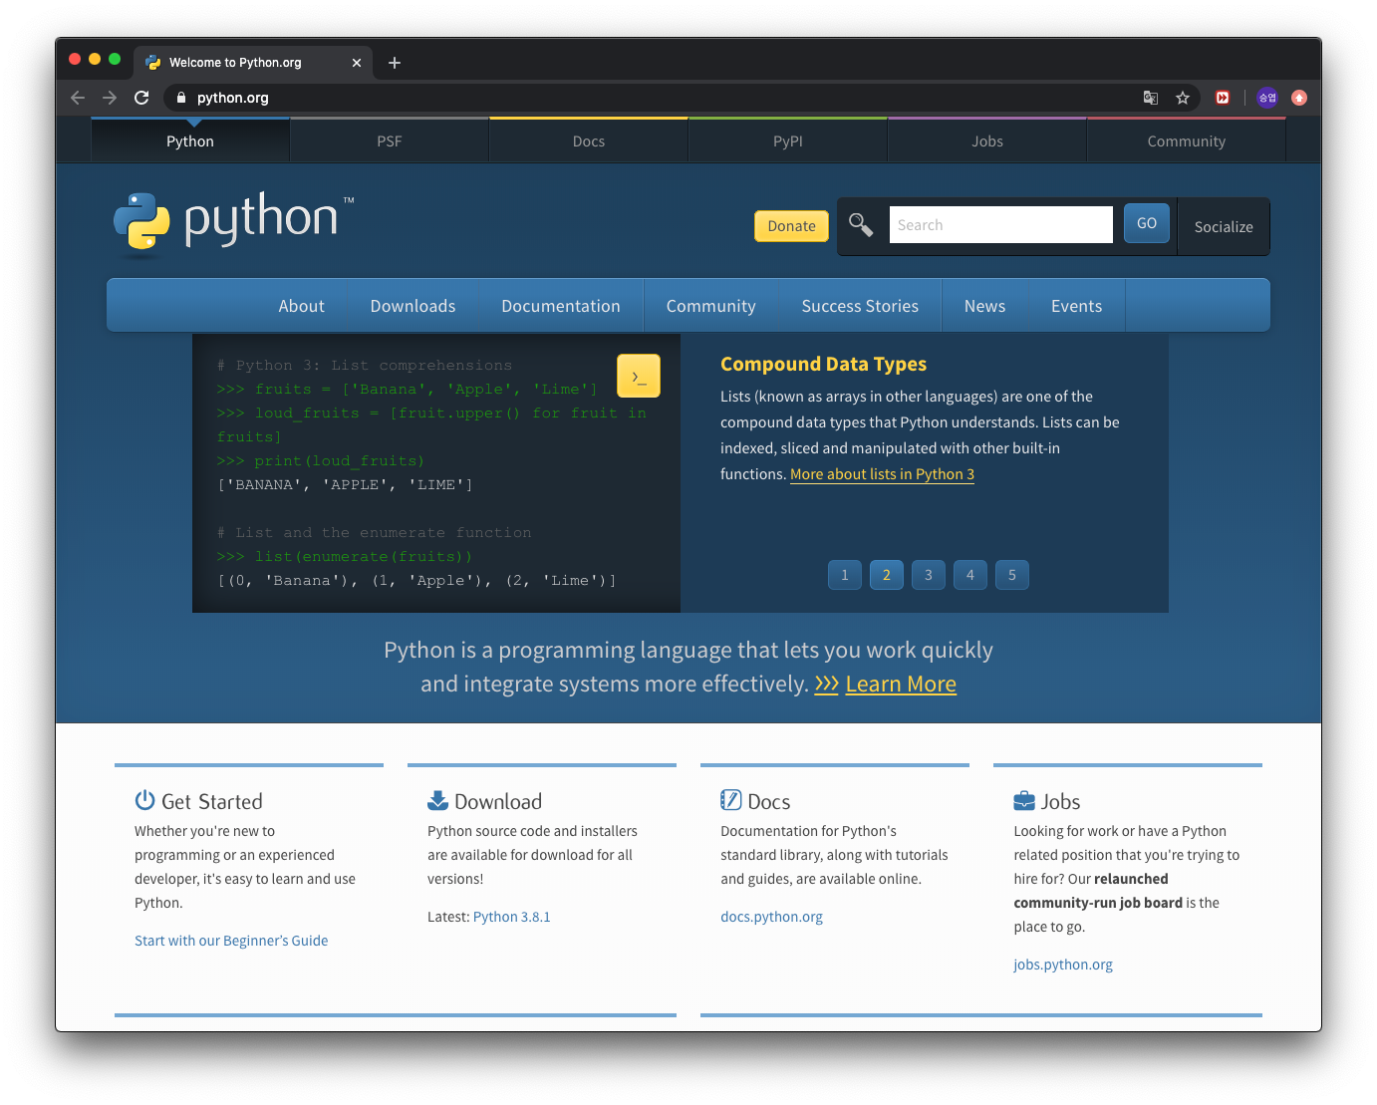
install python
1. install & setup
https://python.org

Slide 6
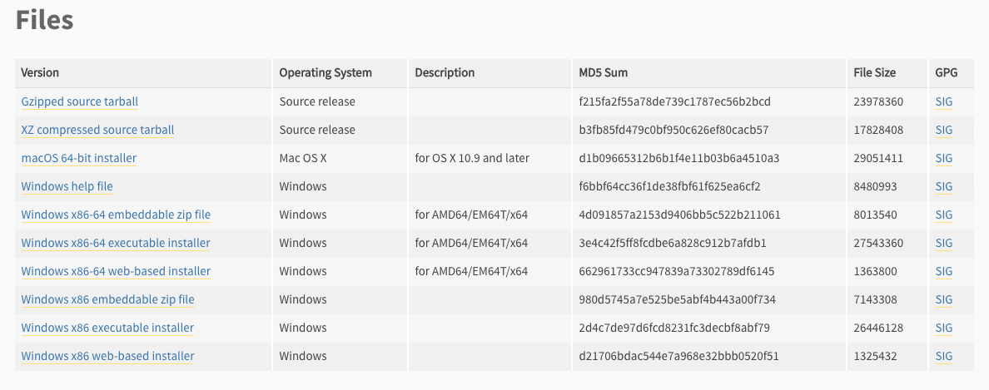
install python
1. install & setup

Slide 7
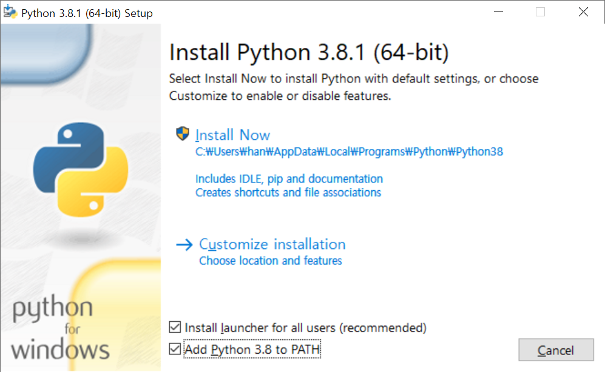
install python
1. install & setup

Slide 8
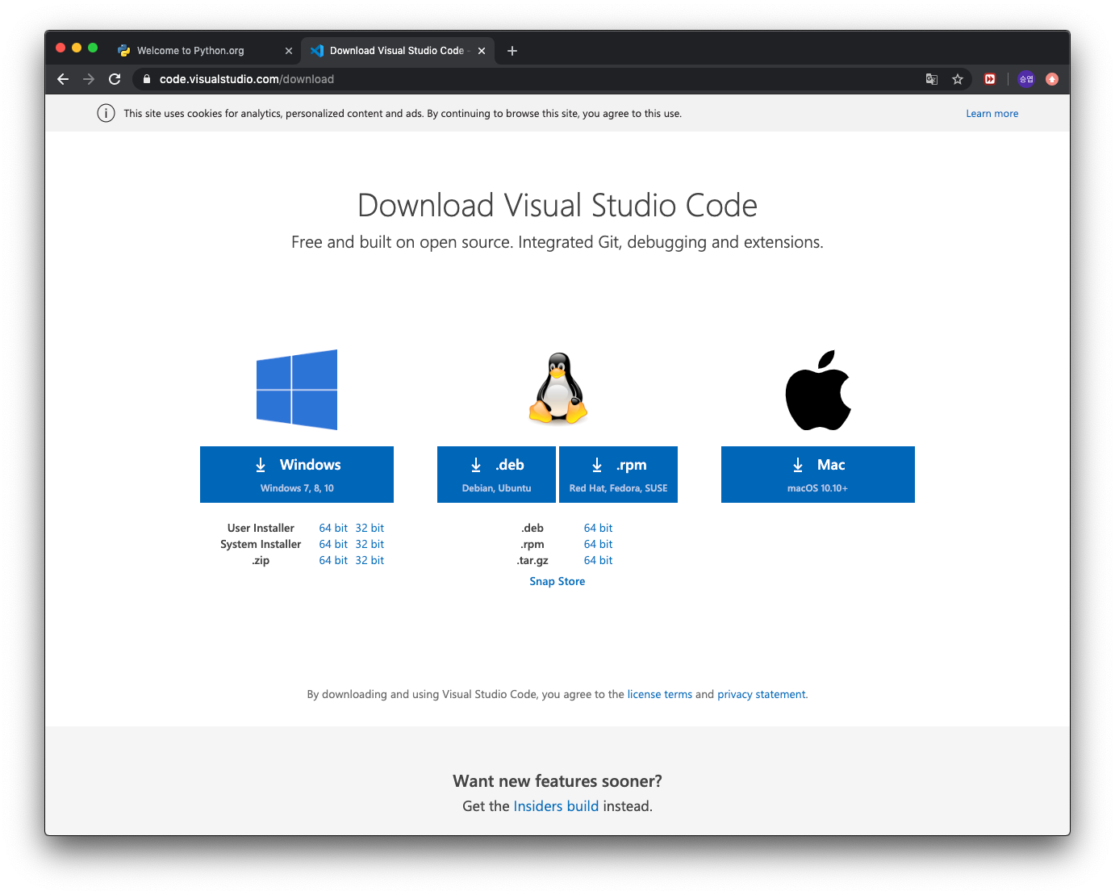
install visual studio code
1. install & setup
https://code.visualstudio.com/download

Slide 9
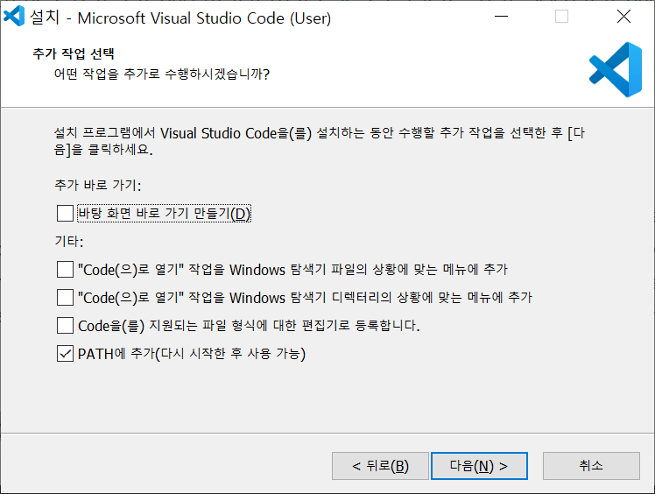
install visual studio code
1. install & setup

Slide 10
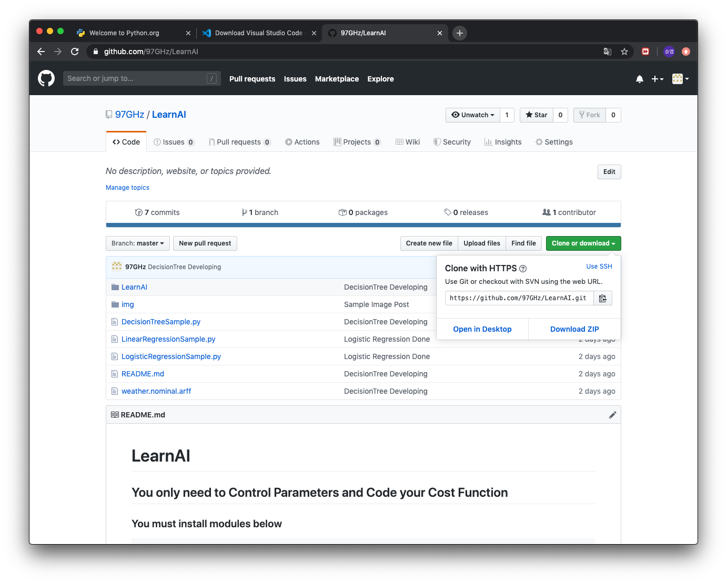
download modules and samples
1. install & setup
https://github.com/97GHz/LearnAI

Slide 11
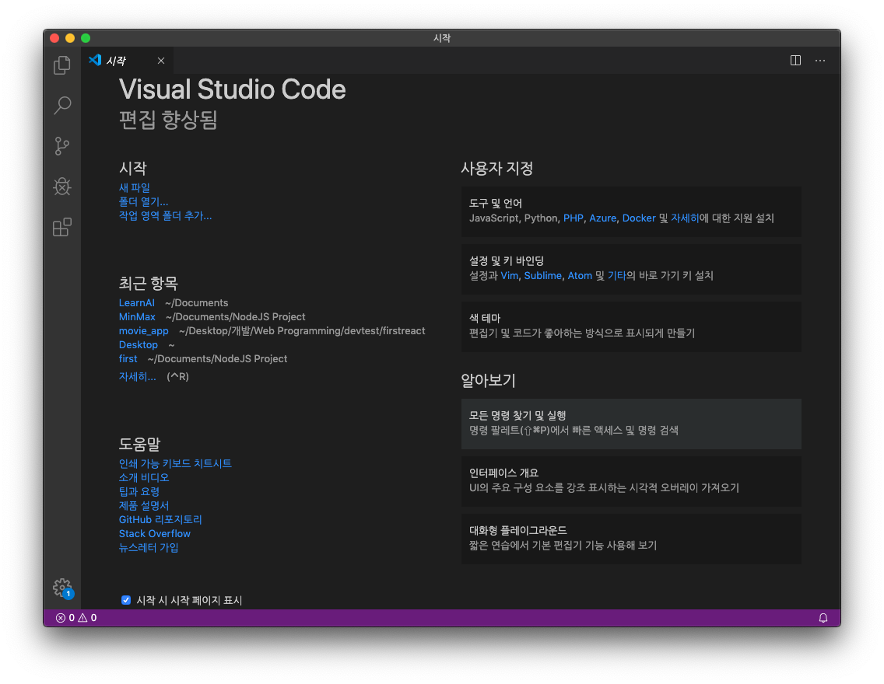
1. install & setup

Slide 12
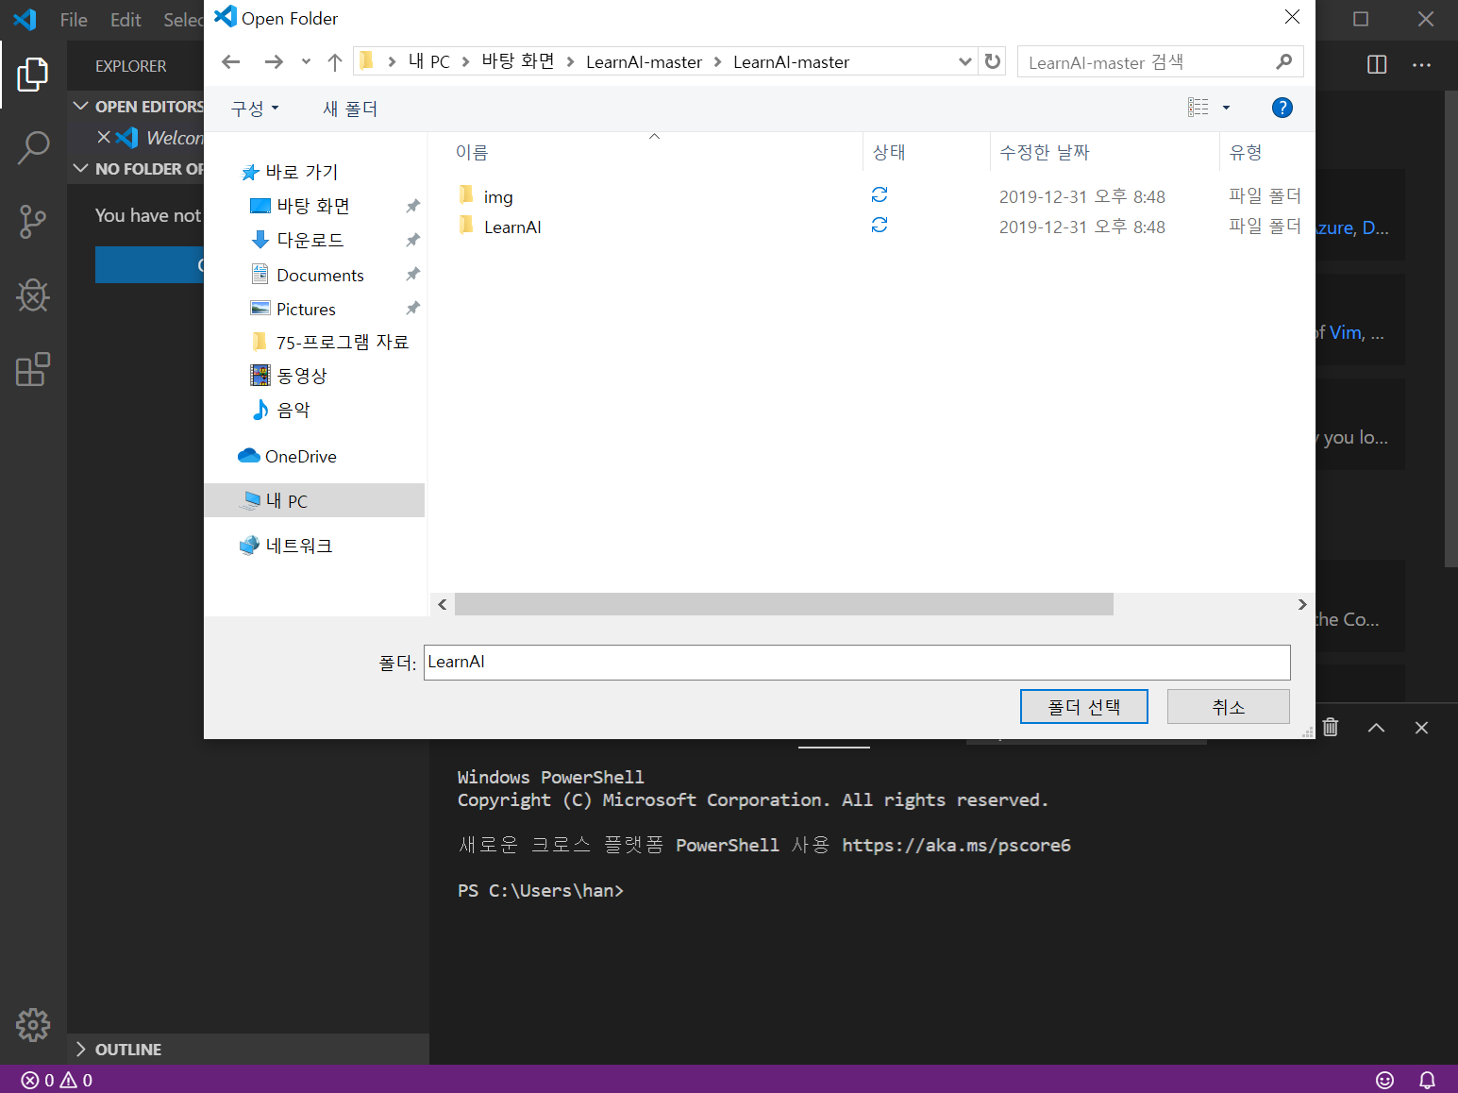
1. install & setup
경로를 압축 푼 폴더로 설정

Slide 13
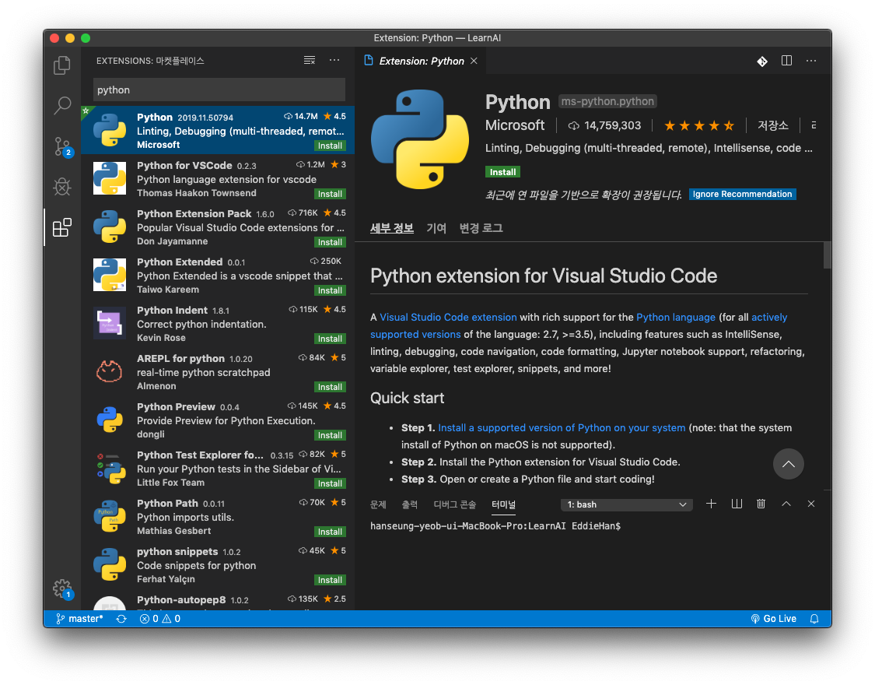
1. install & setup
②
③
④
①

Slide 14
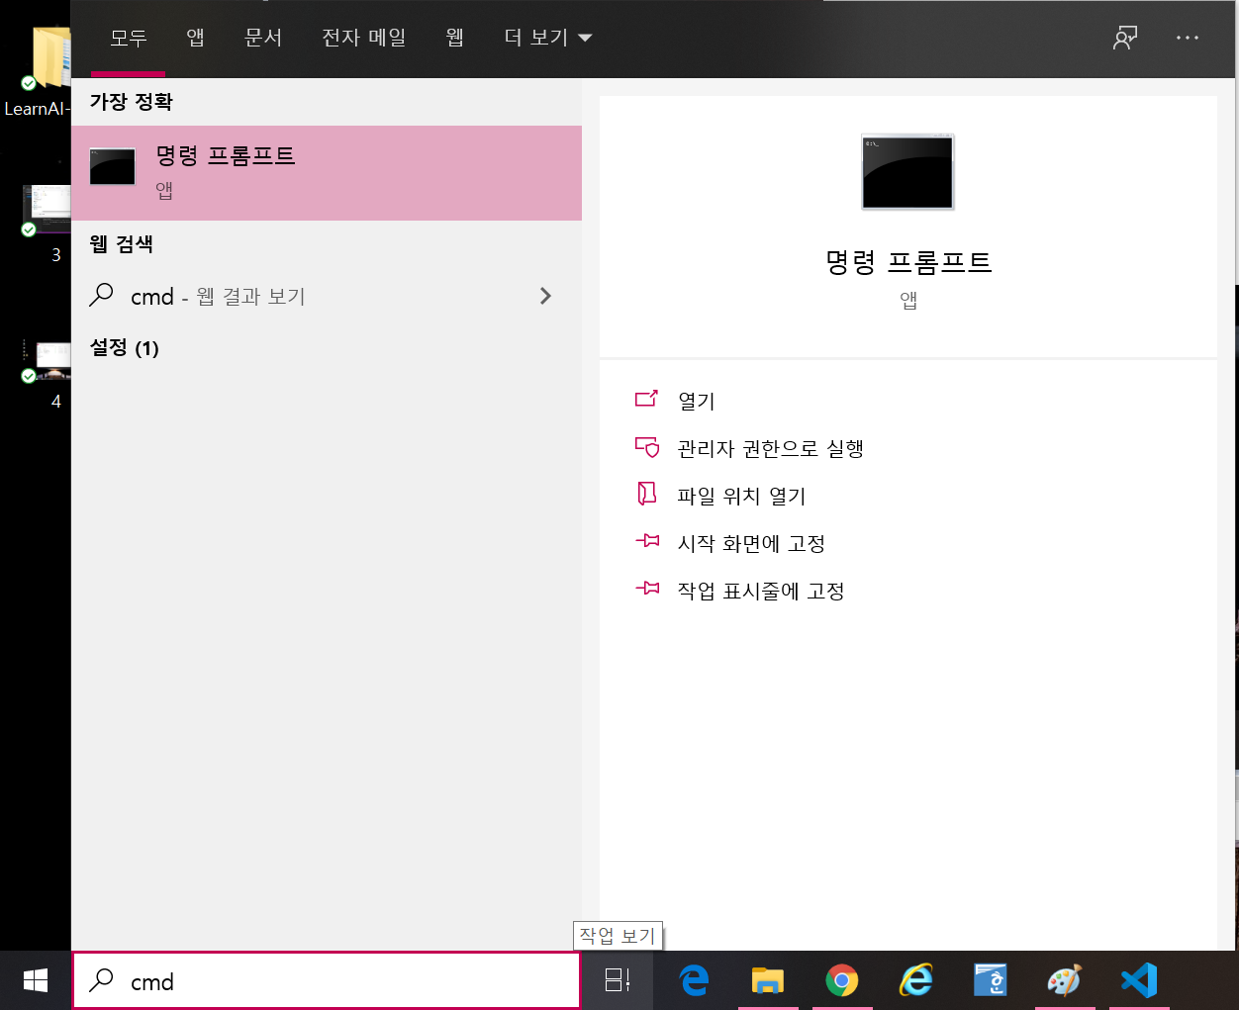
install python modules
1. install & setup

Slide 15
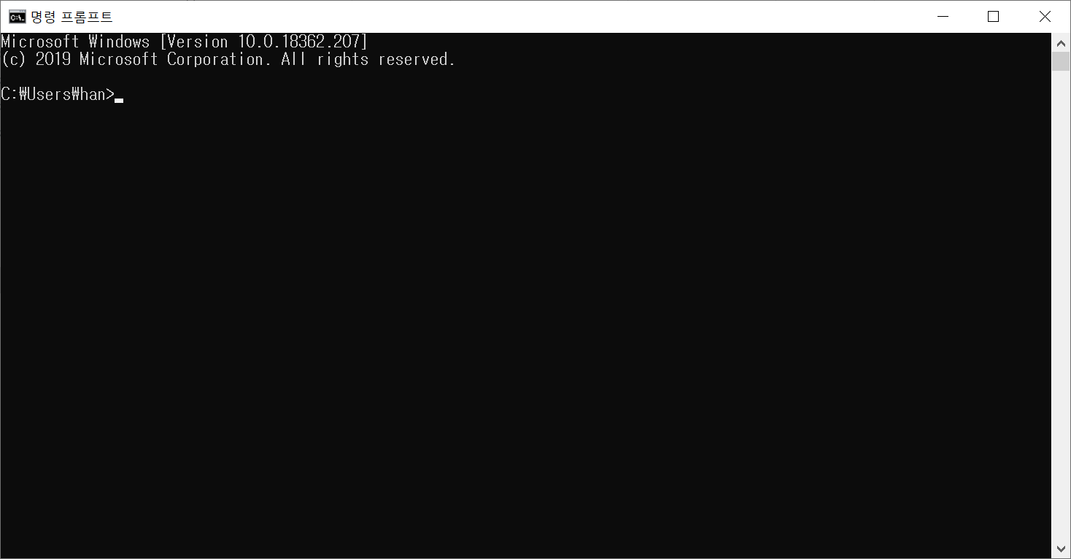
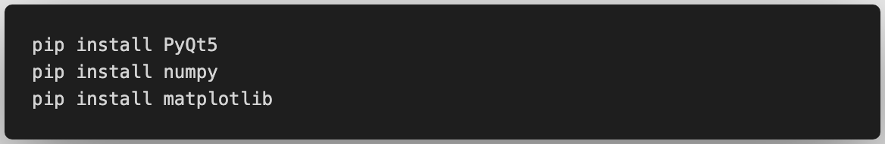
install python modules
1. install & setup
대소문자 주의!

Slide 16
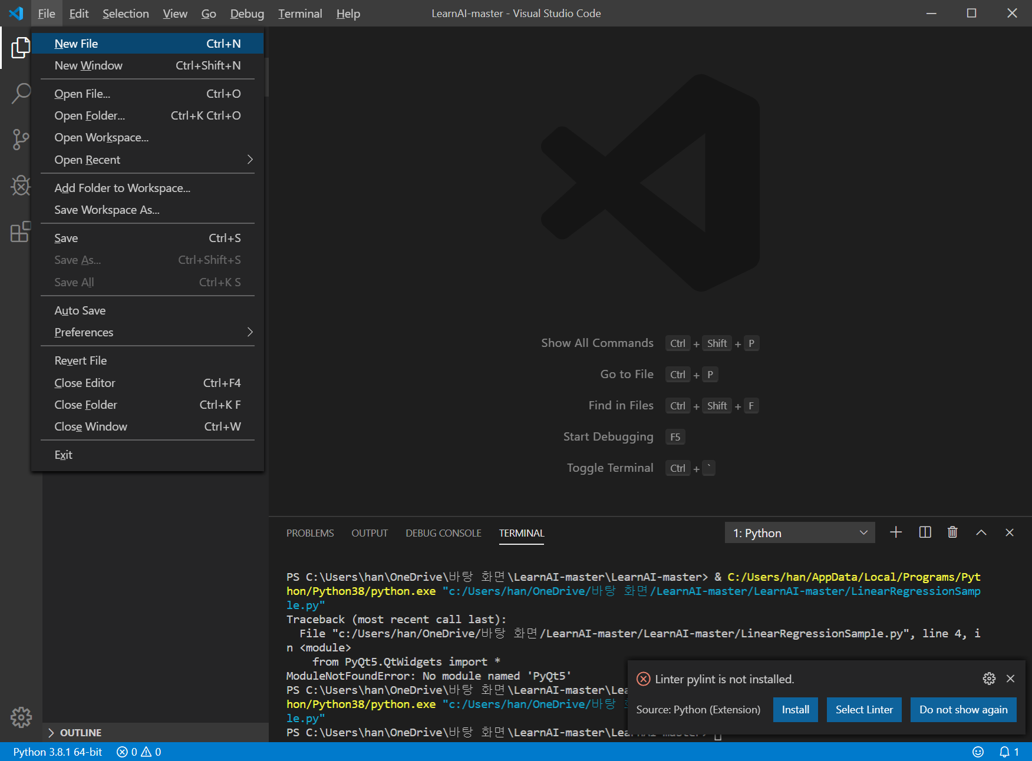
1. install & setup
①
②

Slide 17
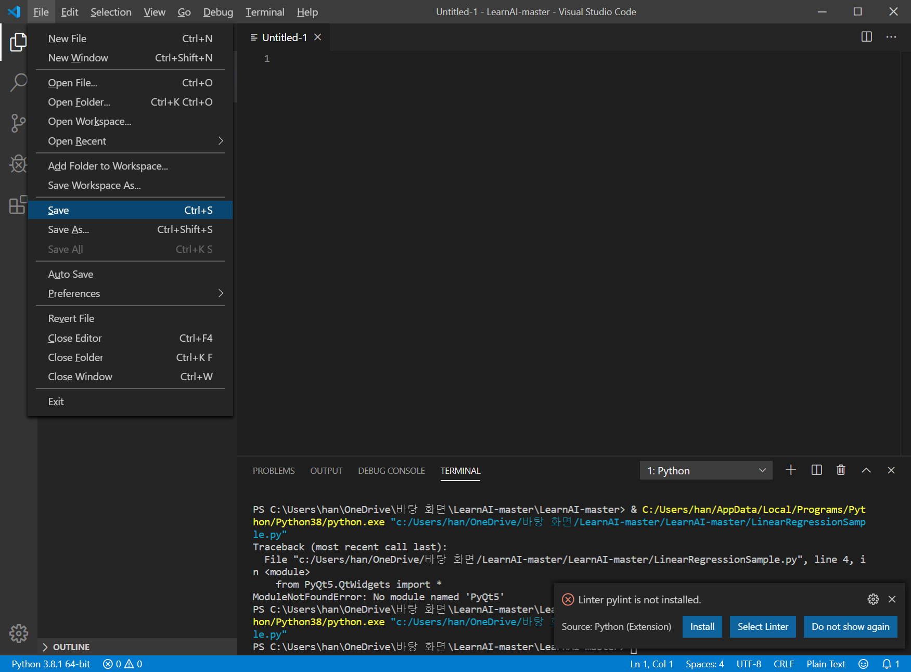
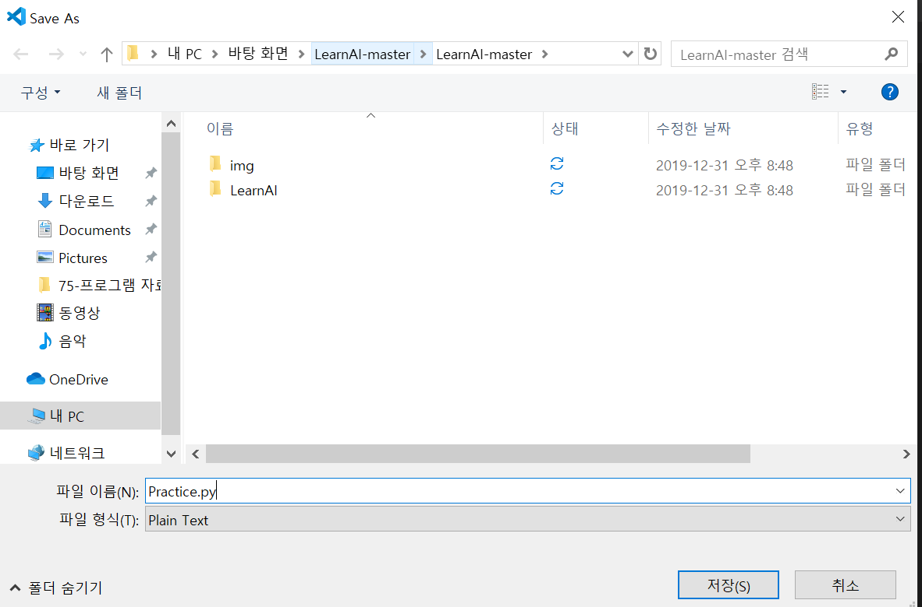
1. install & setup
①
②
③
④

Slide 18
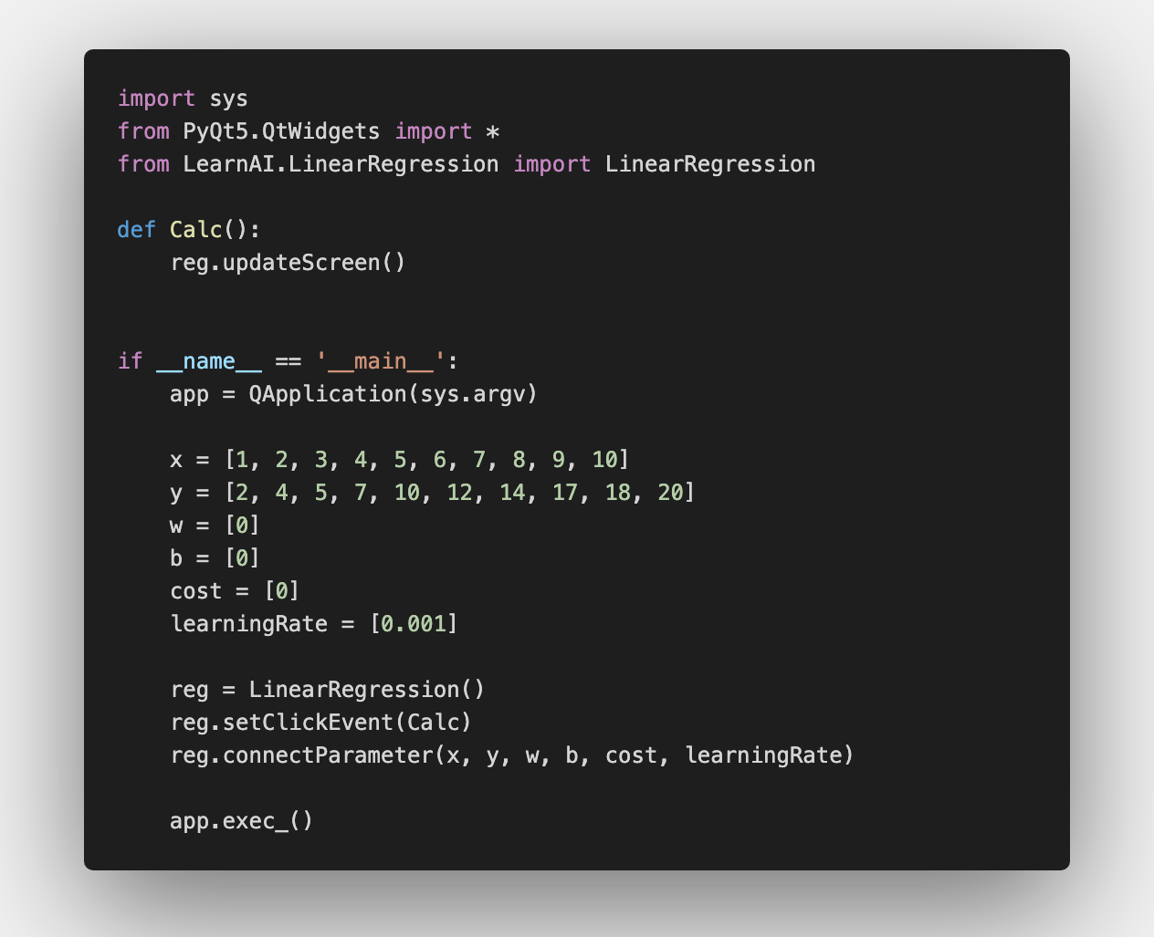
follow up
1. install & setup

Slide 19
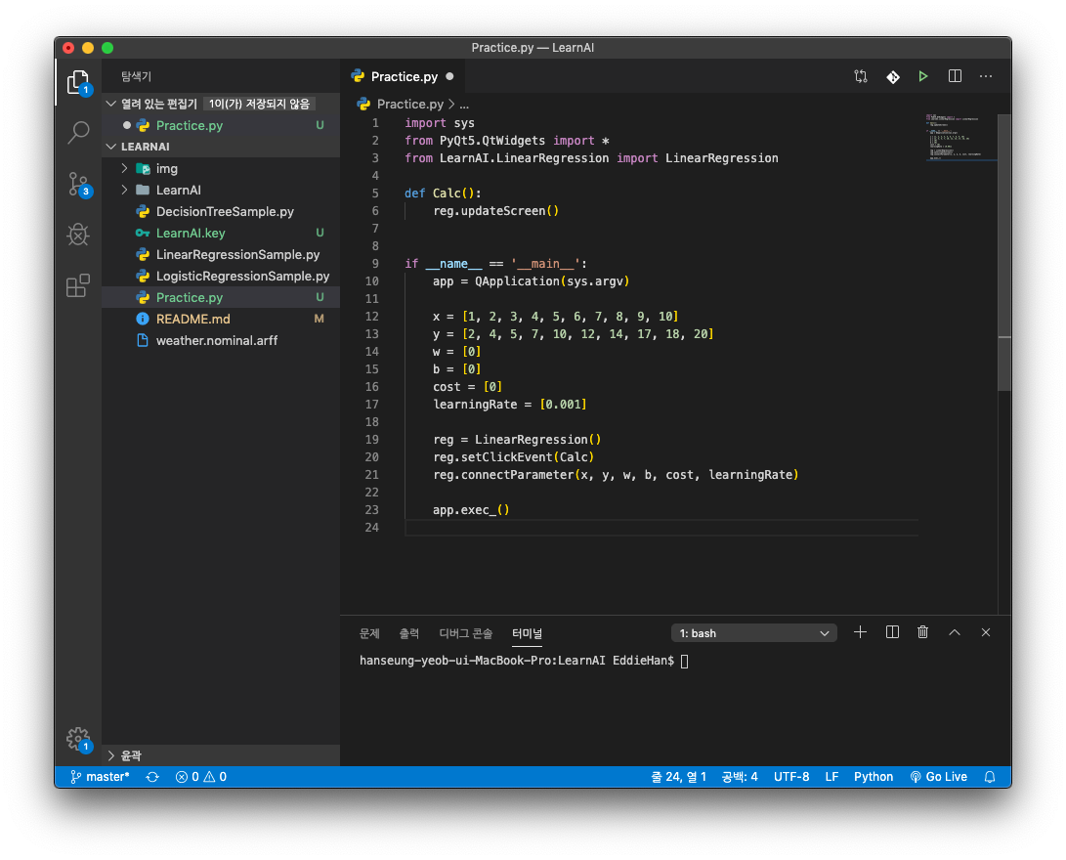
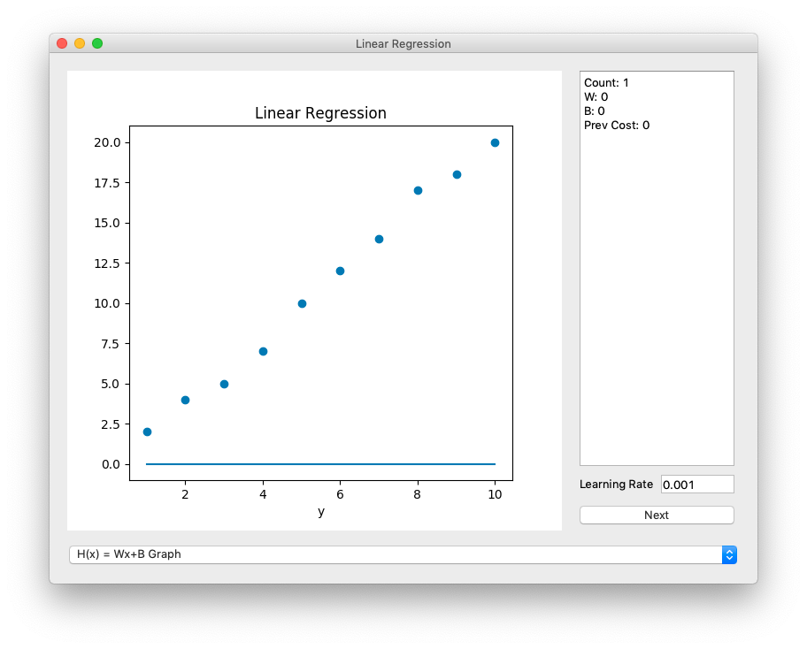
follow up
1. install & setup

Slide 20
what is linear?
2. linear regression

Slide 21
what is linear?
2. linear regression

Slide 22
why linear?
2. linear regression
걷는 걸음 수에 따른 체중 변화?
오늘 평균 기온에 따른 어묵 판매량?
평 수에 따른 월세 비용?

Slide 23
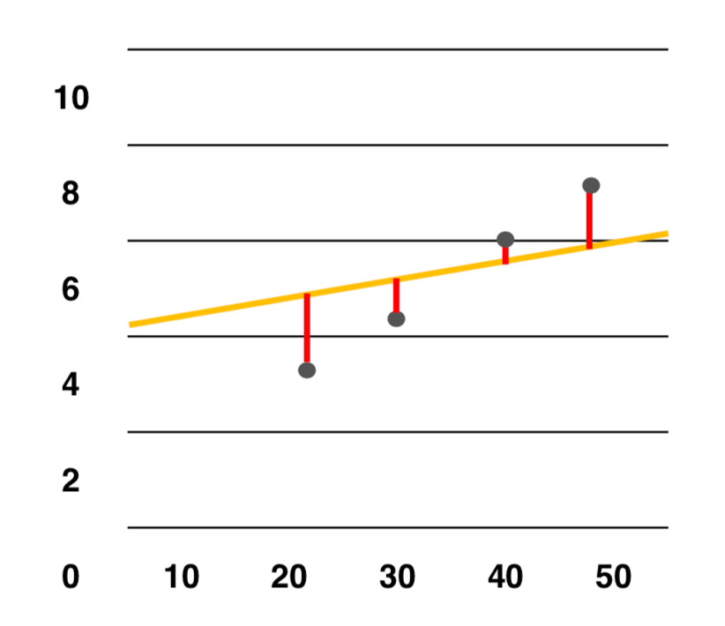


why linear?
2. linear regression

Slide 24
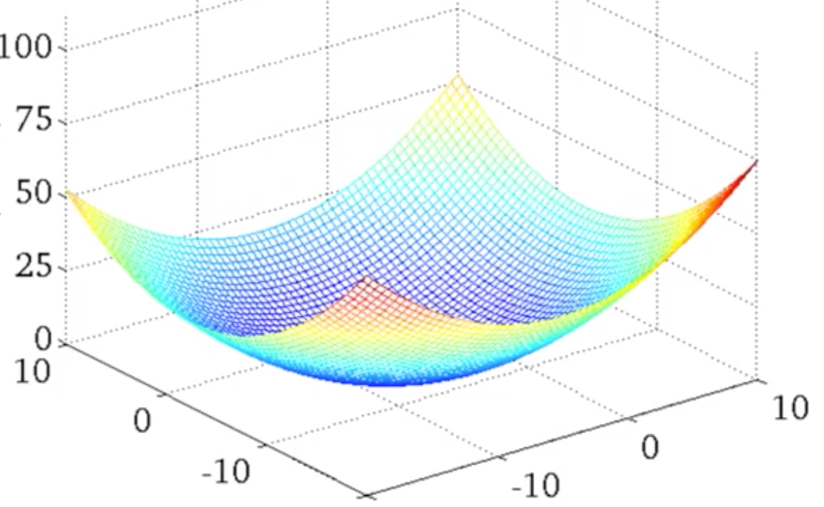

why linear?
2. linear regression
cost
w
b

Slide 25




why linear?
2. linear regression
Must update weights simultaneously

Slide 26
code review
2. linear regression

Slide 27
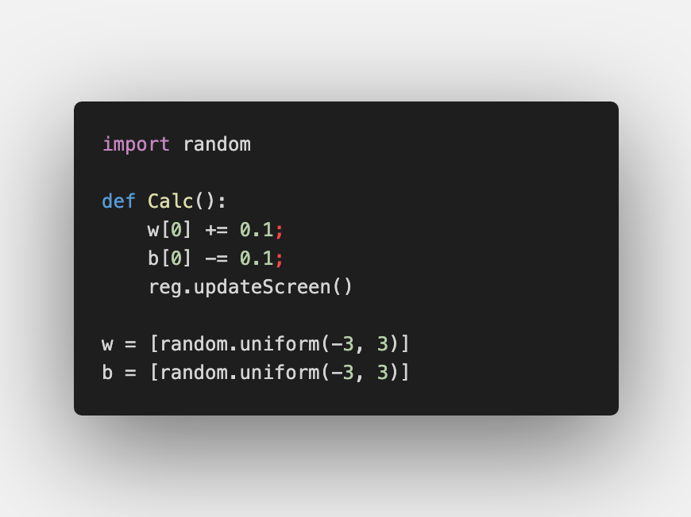
changing parameters
2. linear regression

Slide 28
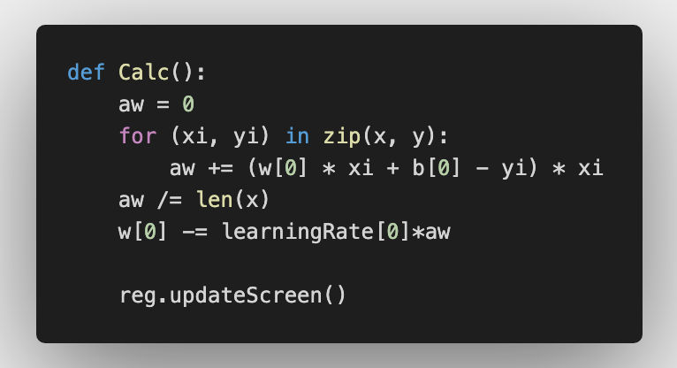
update weight
2. linear regression

Slide 29
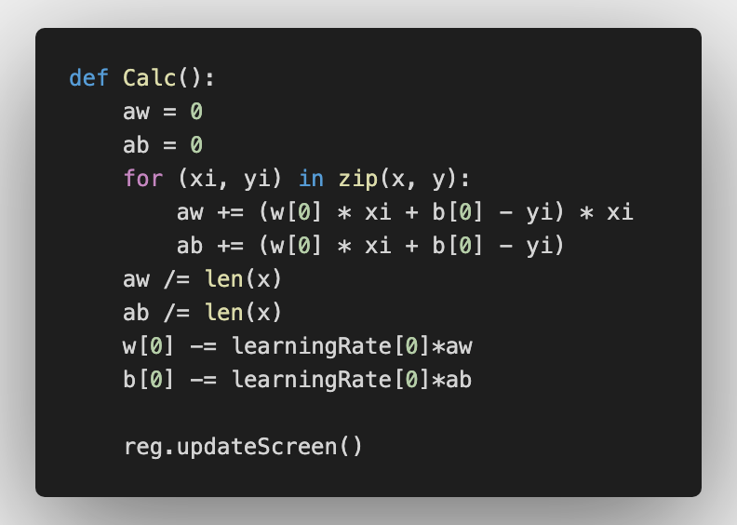
update weight
2. linear regression
Fill the Blanks

Slide 30
update weight
2. linear regression

Slide 31
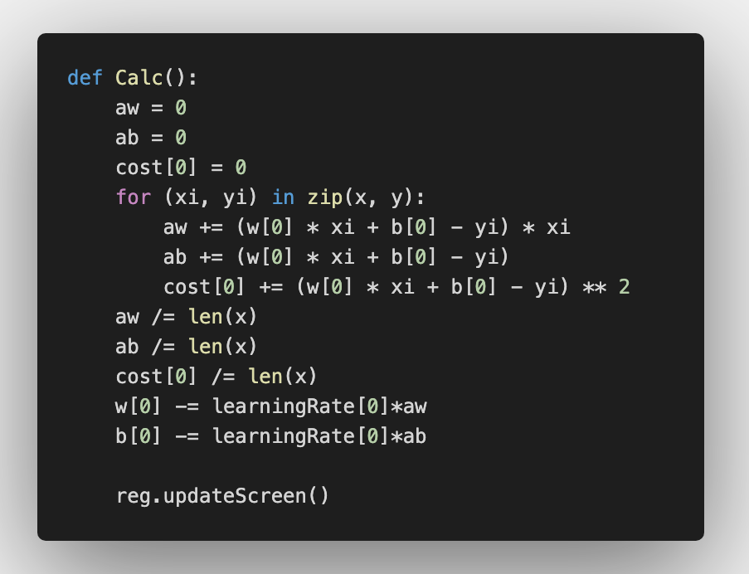
update cost
2. linear regression
Fill the Blanks

Slide 32
update cost
2. linear regression

Slide 33
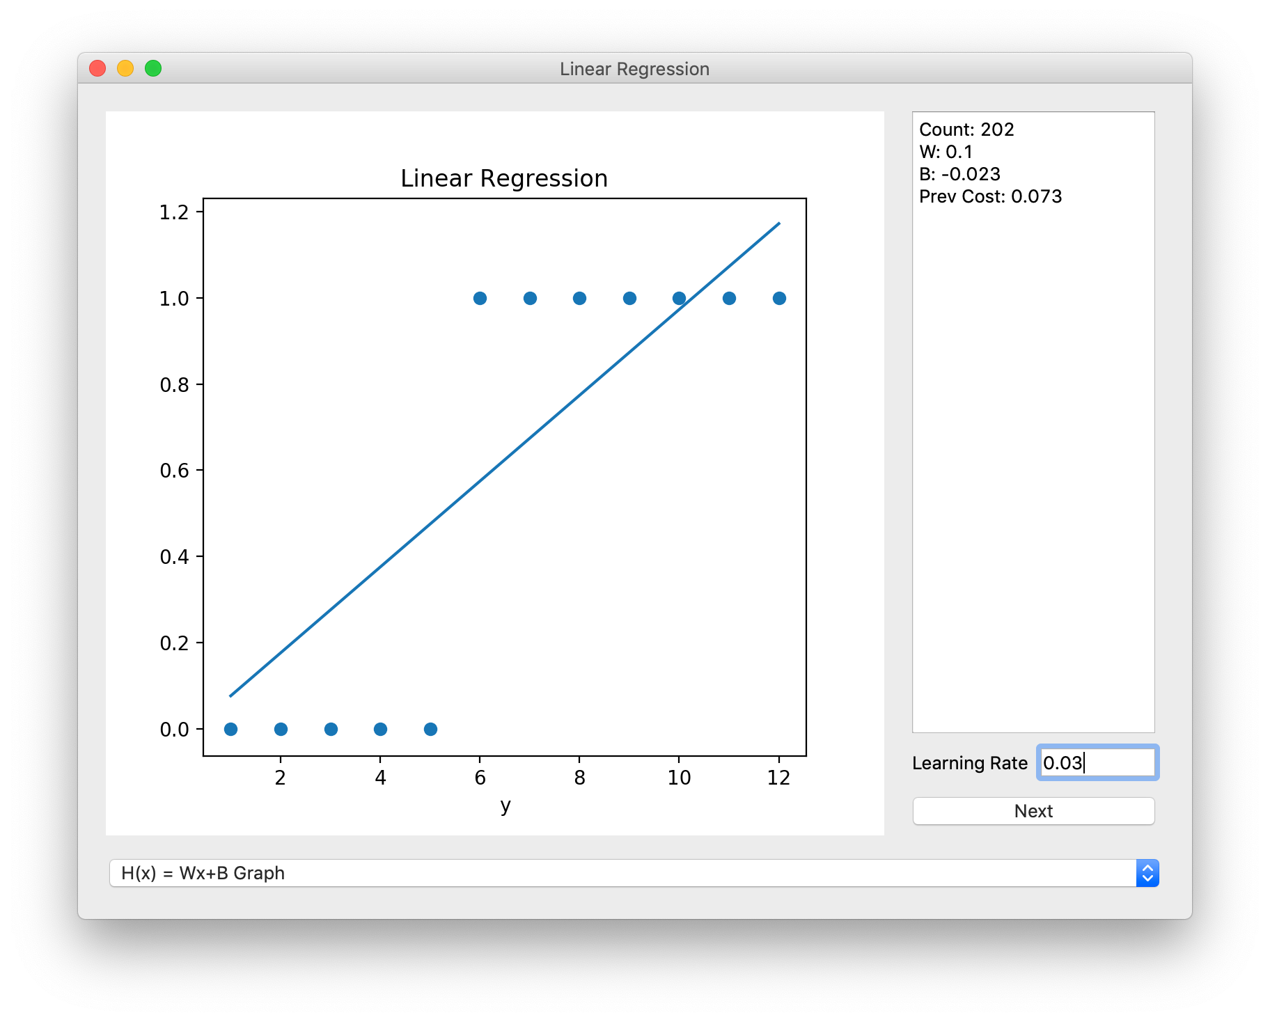
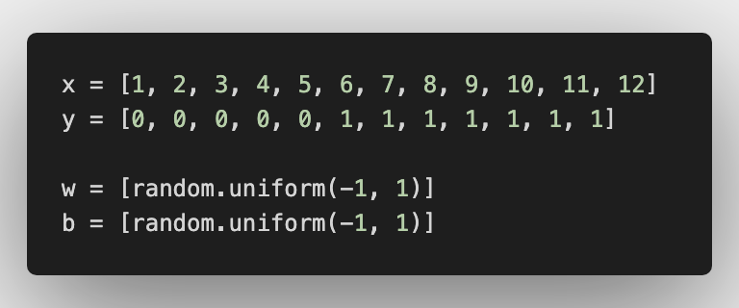
what if data are 0 or 1?
2. linear regression

Slide 34
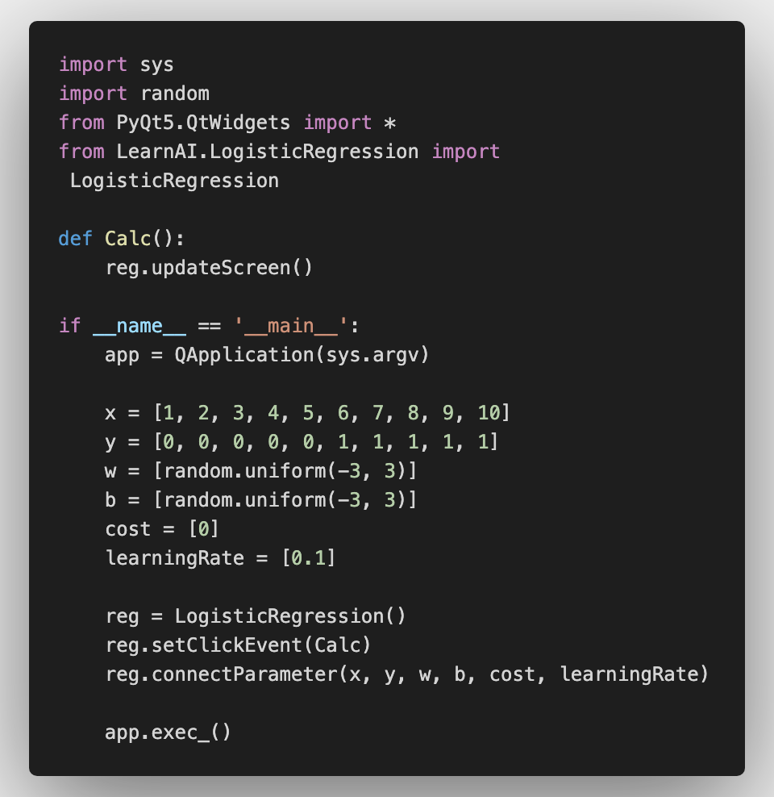
follow up
3. logistic regression

Slide 35
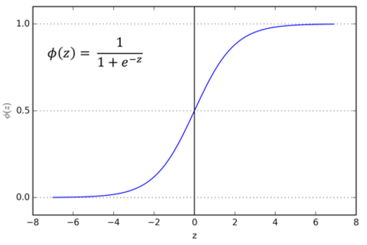

hypothesis
3. logistic regression

Slide 36
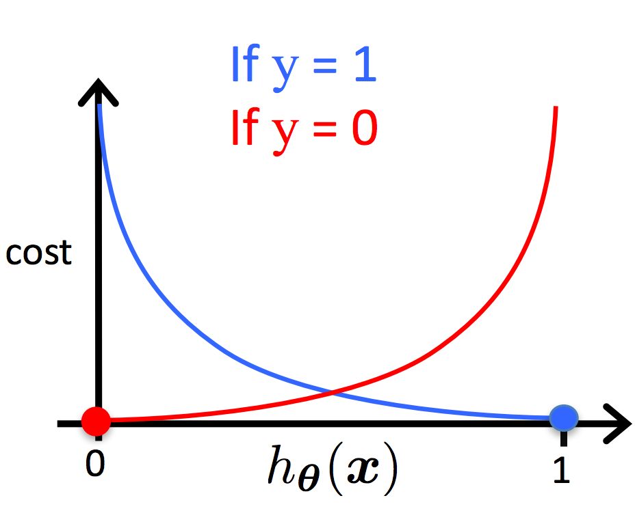



cost function
3. logistic regression

Slide 37



cost function
3. logistic regression

Slide 38


cost function
3. logistic regression

Slide 39
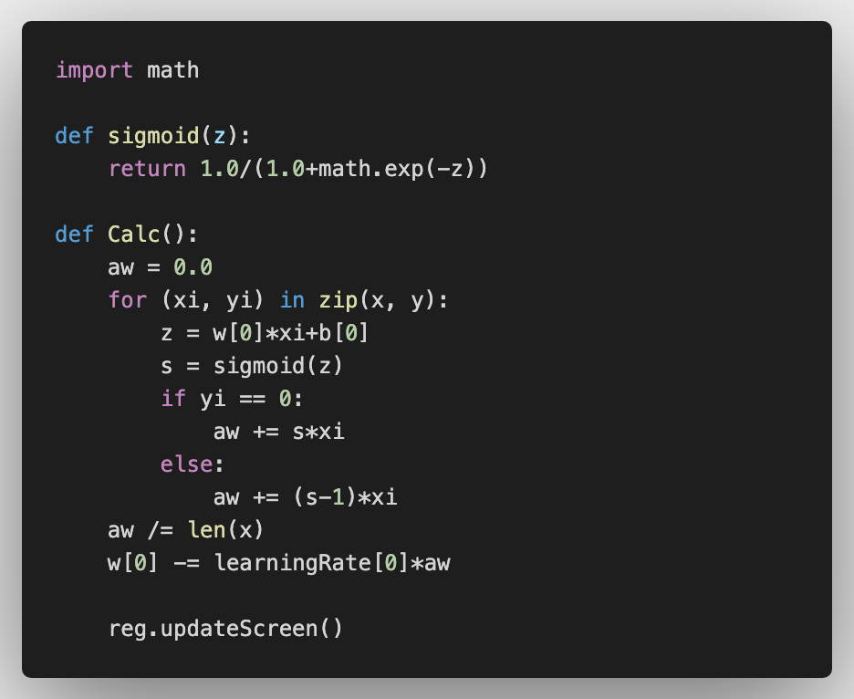
update weights
3. logistic regression

Slide 40
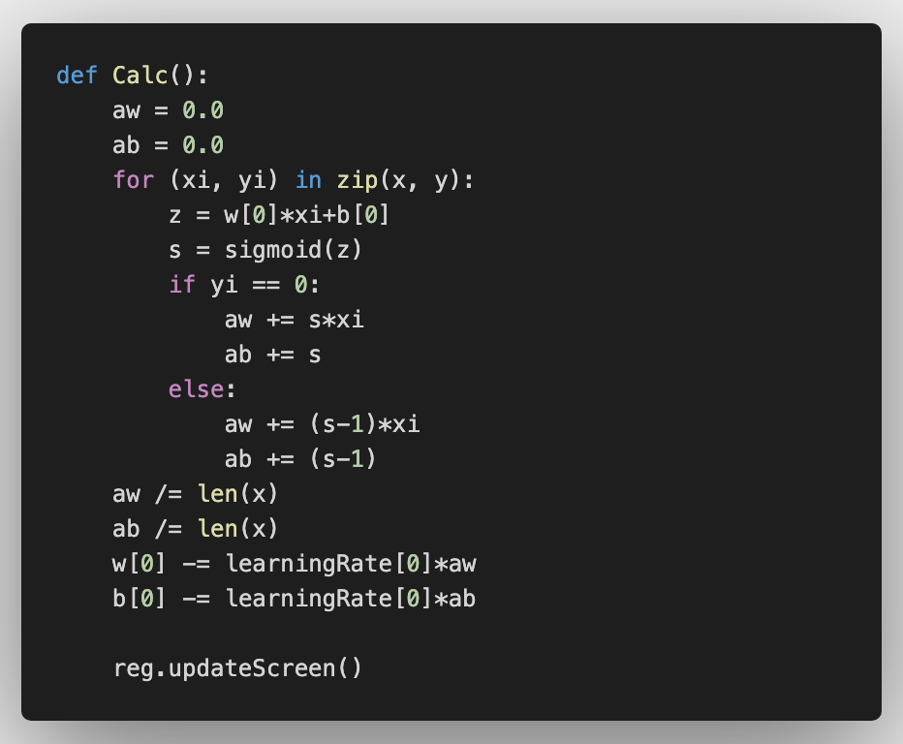
update weights
3. logistic regression
Fill the Blanks

Slide 41
update weights
3. logistic regression

Slide 42
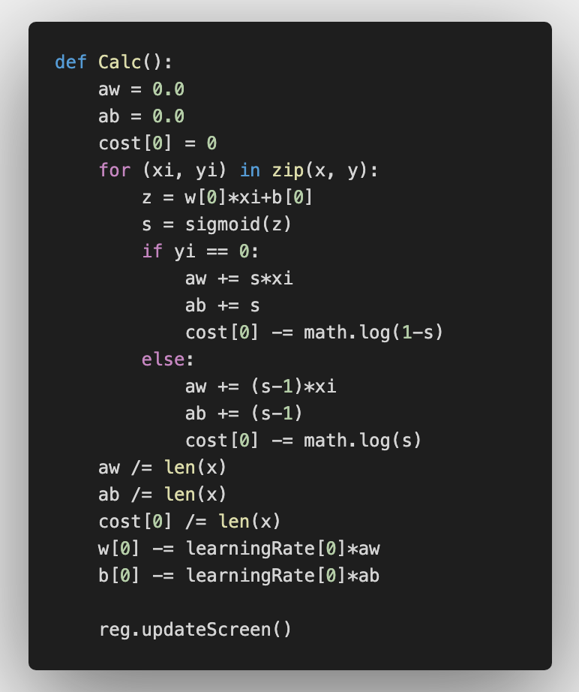
update cost
3. logistic regression
Fill the Blanks

Slide 43
update cost
3. logistic regression

Slide 44
what is decision tree?
4. decision tree
attribute
Value
Value
attribute
class
Value
Value
class
class
Attribute = {Value1, Value2, Value3, …}

Slide 45
what is decision tree?
4. decision tree
성별
남성
여성
신체 검사 등급
징집 대상 X
등급 <= 3
등급 >= 4
징집 대상 O
징집 대상 X
성별 = {남성, 여성}
등급 = {1, 2, 3, 4, 5, 6}

Slide 46
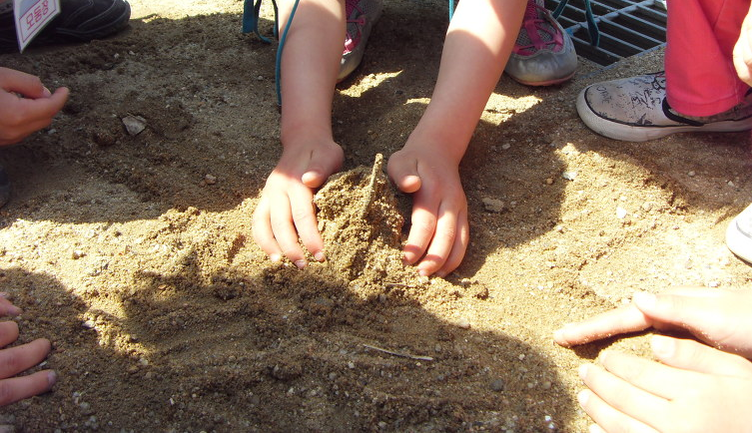
How to make decision tree?
4. decision tree

Slide 47
How to make decision tree?
4. decision tree
color
Attribute
- Color
- Shape
- Size

Slide 48
How to make decision tree?
4. decision tree
shape
Attribute
- Color
- Shape
- Size

Slide 49
How to make decision tree?
4. decision tree
size
Attribute
- Color
- Shape
- Size

Slide 50
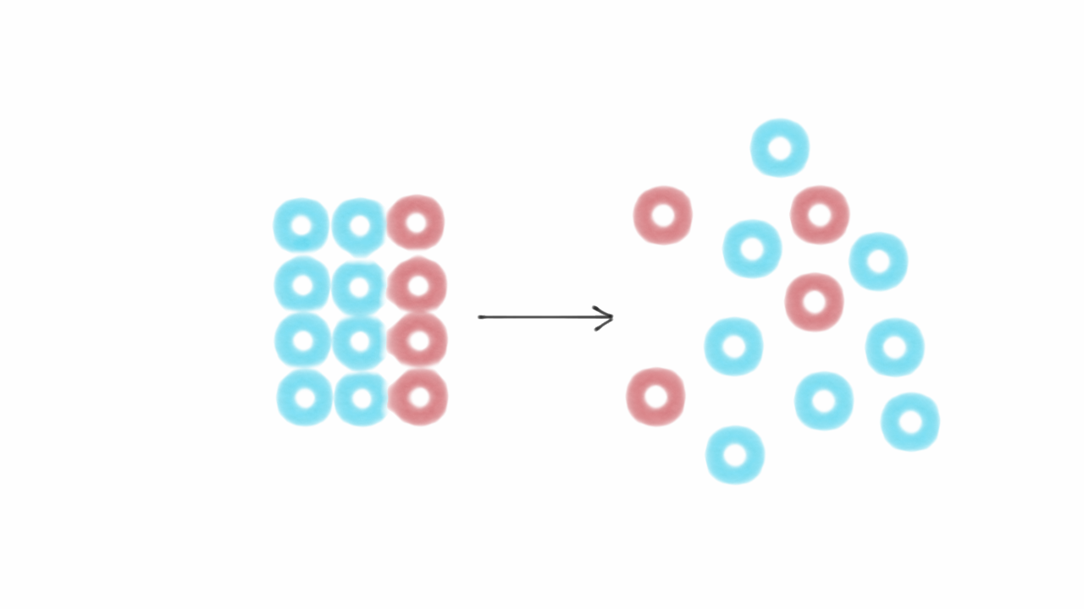
How to make decision tree?
4. decision tree
테스트 샘플의 엔트로피가 0에 가까울수록 분류가 잘 됨

Slide 51
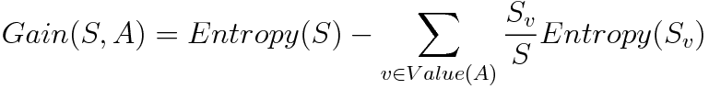
How to make decision tree?
4. decision tree
어떤 Attribute를 선택했을 때 엔트로피 얼마나 줄어드는지?

Slide 52
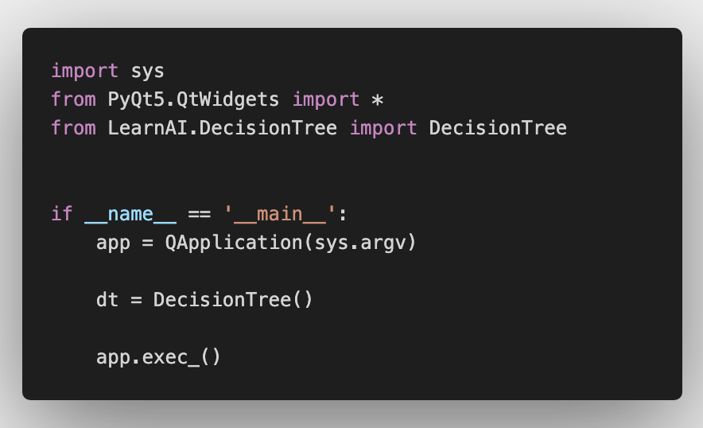
follow up
4. decision tree

Slide 53
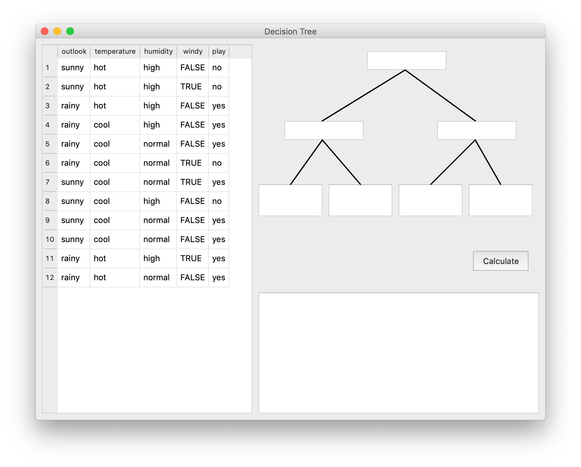
follow up
4. decision tree
Input the Attributes and Make Entropy smaller!

Slide 54
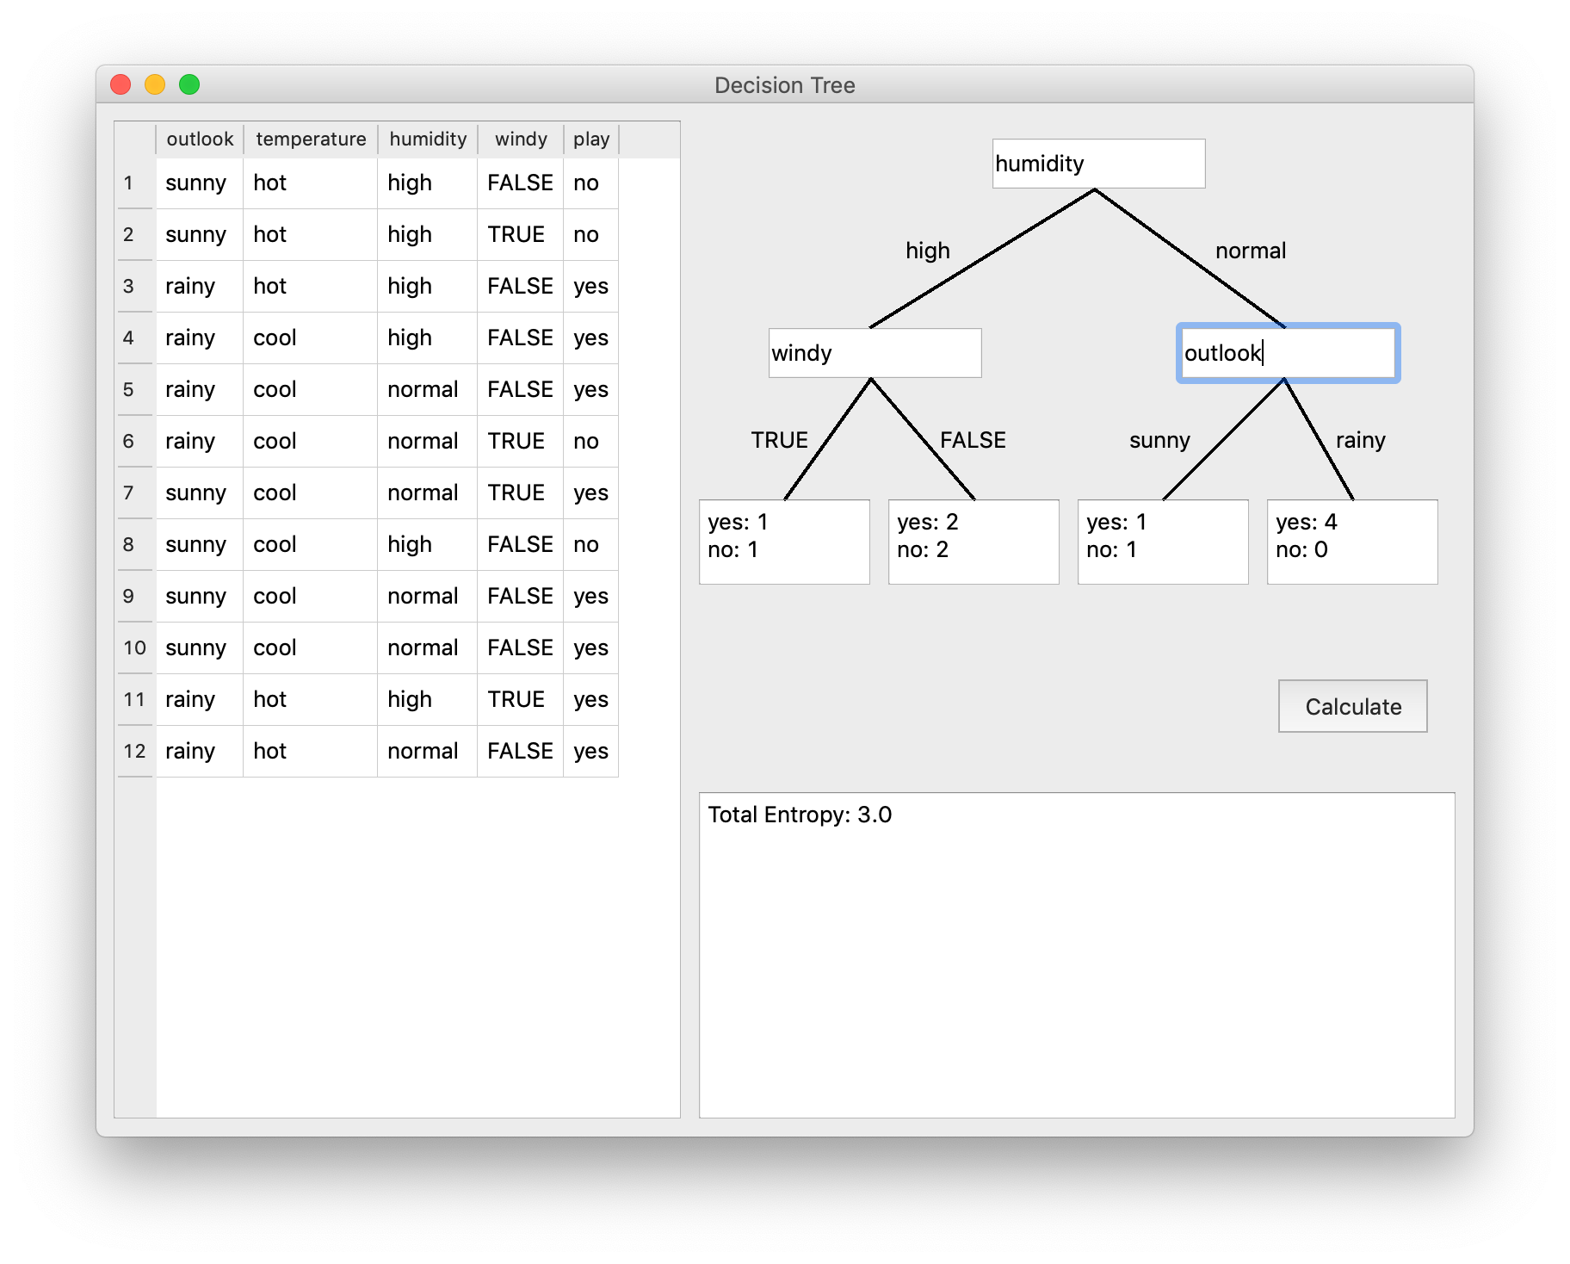
follow up
4. decision tree

Slide 55
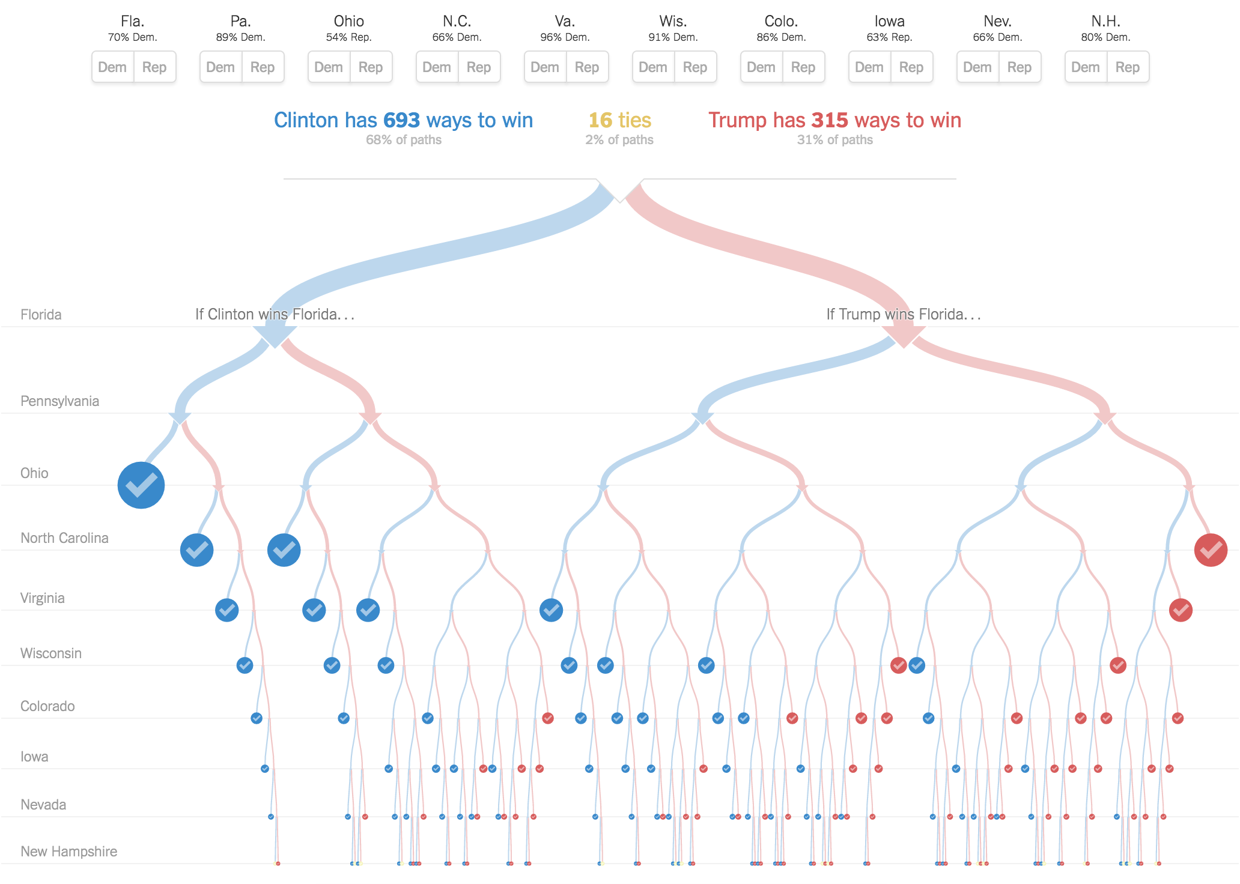
deep decision tree?
4. decision tree

Slide 56
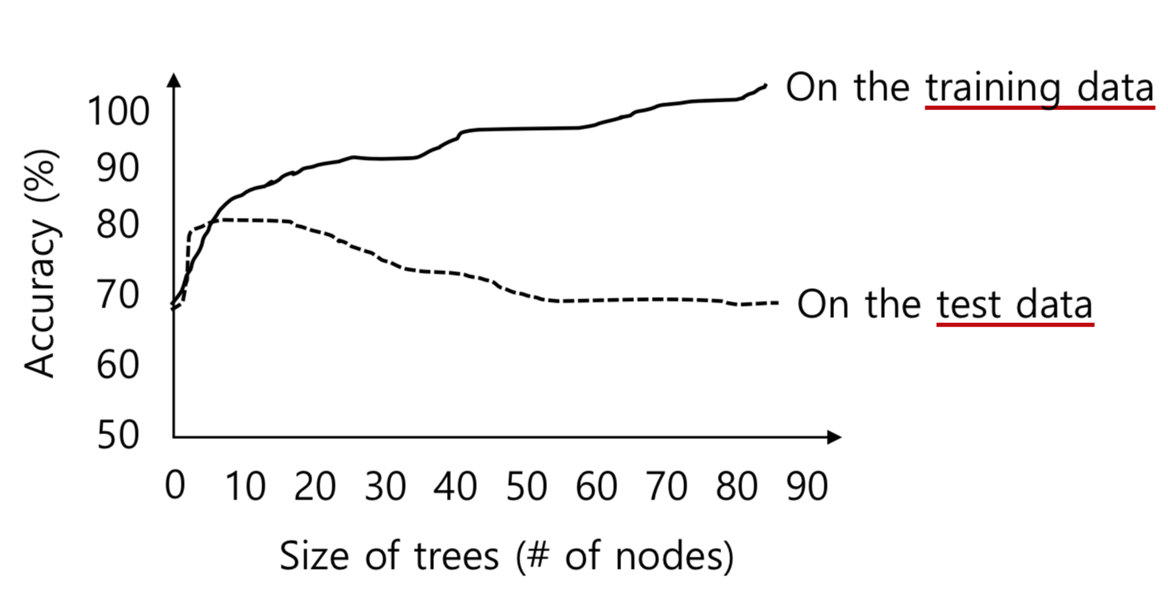
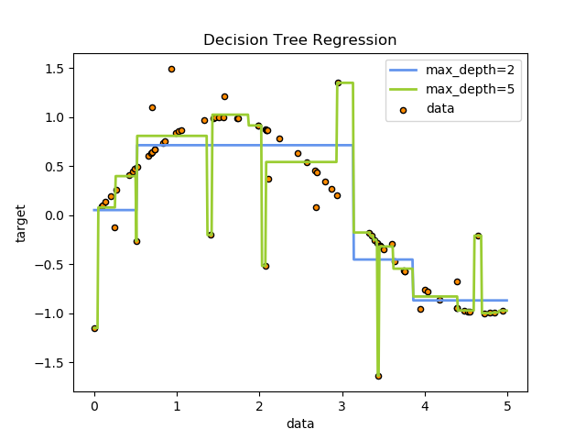
deep decision tree?
4. decision tree
Overfitting Problem

Slide 57
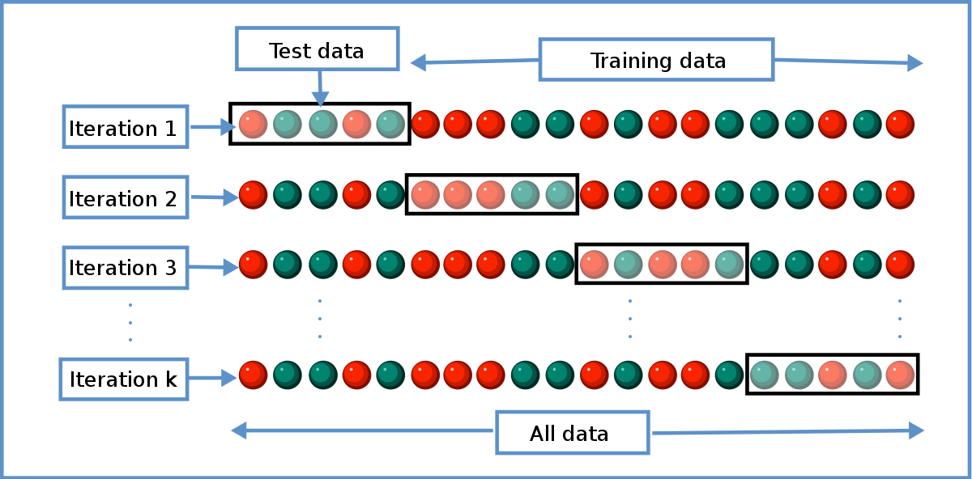
cross validating
4. decision tree

Slide 58
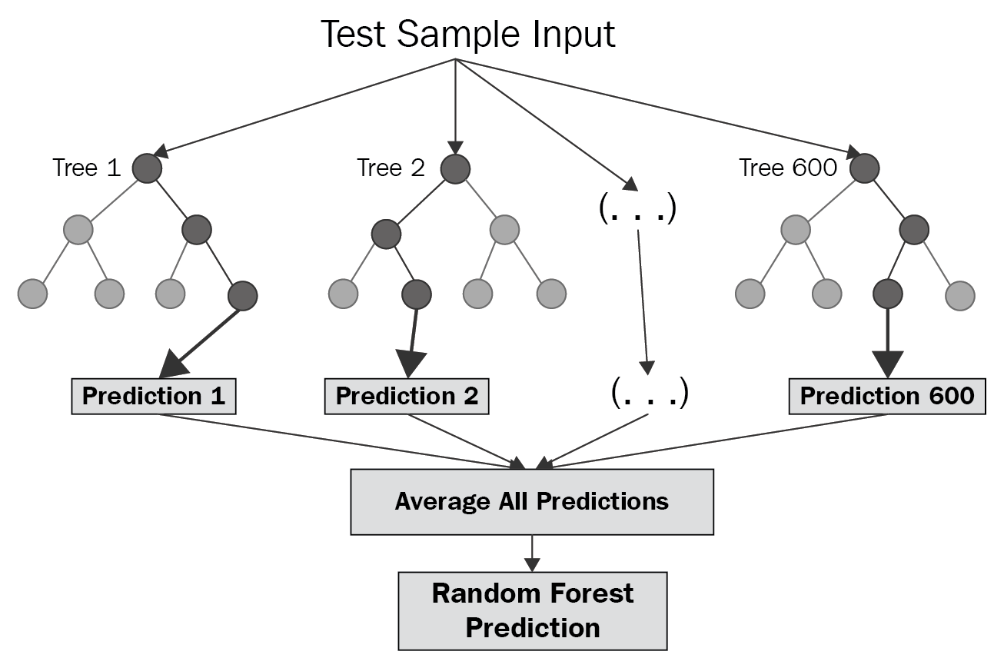
random forest
4. decision tree

Slide 59
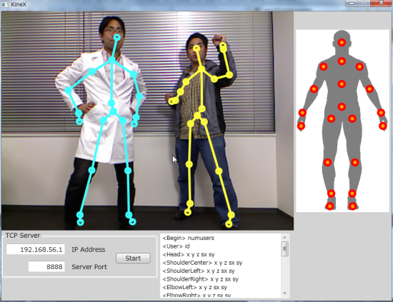
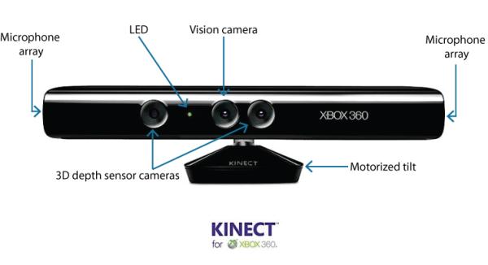
random forest - xbox360 kinect
4. decision tree

Slide 60
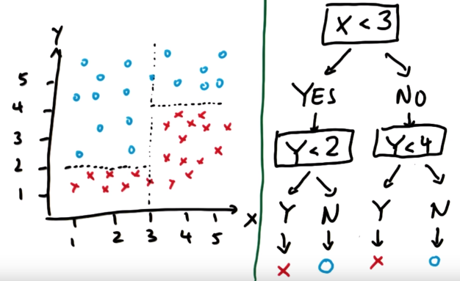
only discrete data are used?
4. decision tree

Slide 61
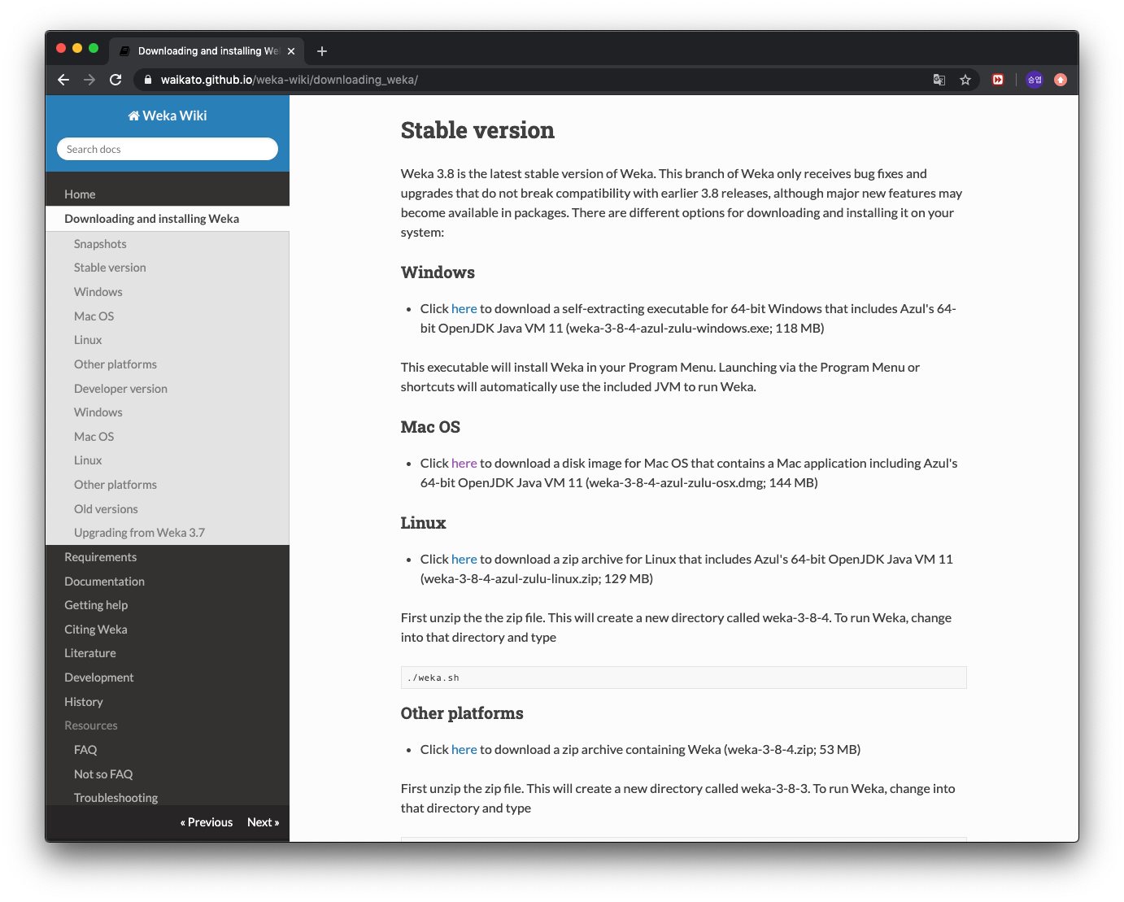
weka
4. decision tree
https://waikato.github.io/weka-wiki/downloading_weka/

Slide 62
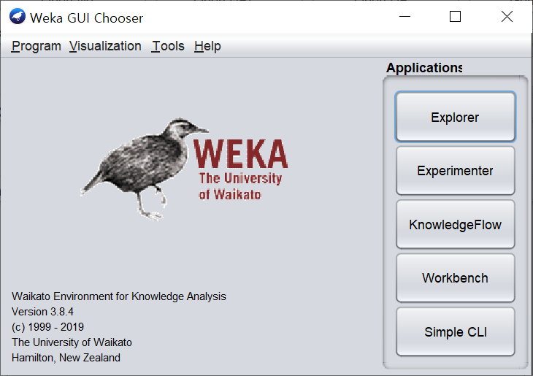
weka
4. decision tree

Slide 63
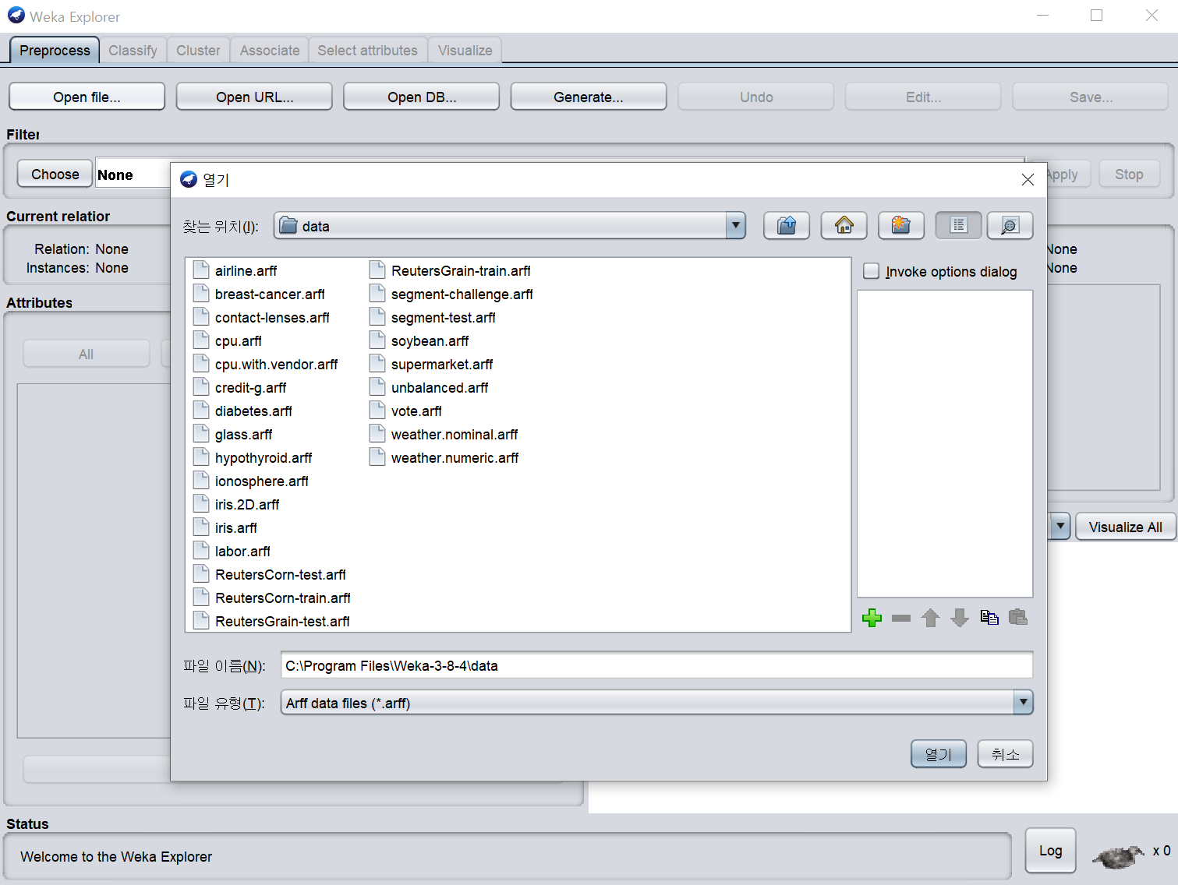
weka
4. decision tree

Slide 64
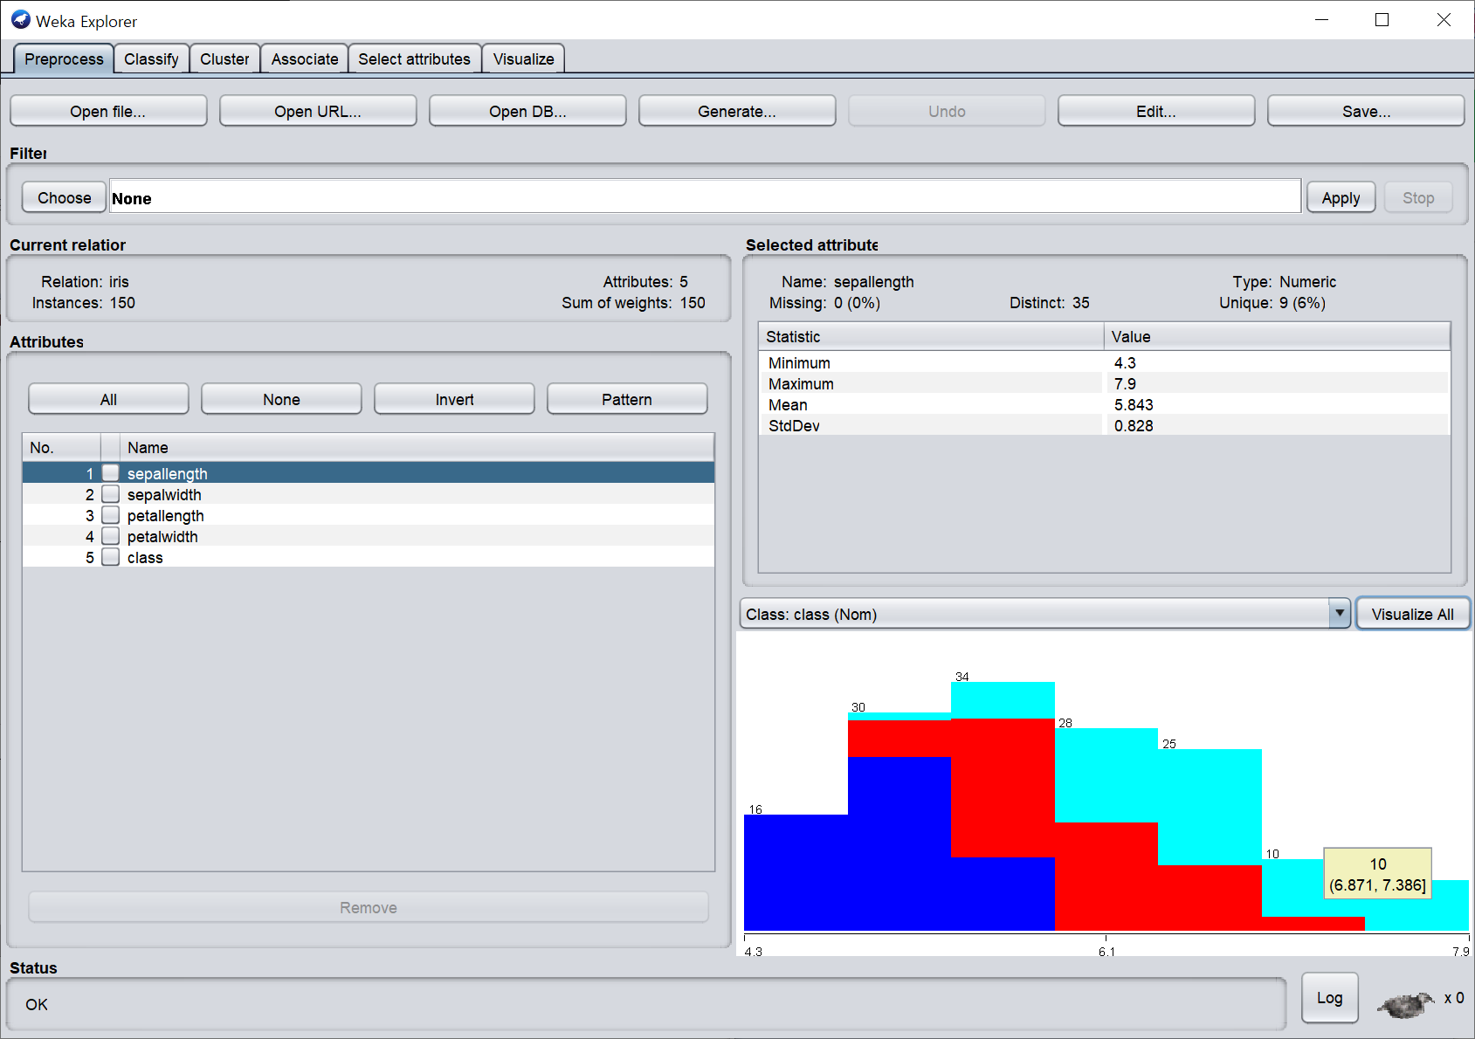
weka
4. decision tree

Slide 65

weka
4. decision tree

Slide 66


weka
4. decision tree

Slide 67

weka
4. decision tree

Slide 68


weka
4. decision tree

Slide 69

defect of supervised learning
5. k-mean clustering

Slide 70

defect of supervised learning
5. k-mean clustering
AI의 머신러닝, 알고보니 中·인도의 값싼 노동력 덕분
https://biz.chosun.com/site/data/html_dir/2019/12/19/2019121900144.html

Slide 71

what about k-mean clustering?
5. k-mean clustering

Slide 72
k-mean clustering?
5. k-mean clustering
무작위 K개의 점을 지정

Slide 73
k-mean clustering?
5. k-mean clustering
모든 데이터를 K개의 점 중
제일 가까운 점과 연결

Slide 74
k-mean clustering?
5. k-mean clustering
연결된 점들의 평균 좌표를 구해서
그 좌표로 이동

Slide 75
k-mean clustering?
5. k-mean clustering
움직임이 없어질 때까지 반복

Slide 76

weka
5. k-mean clustering

Slide 77

weka
5. k-mean clustering

Slide 78


weka
5. k-mean clustering

Slide 79
weka
5. k-mean clustering

Slide 80

weka
5. k-mean clustering

Slide 81

weka
5. k-mean clustering

Slide 82

perceptron
6. artificial neural network

Slide 83

perceptron
6. artificial neural network

Slide 84

make and gate with perceptron
6. artificial neural network
x1
w1
x2
w2
s
f
w3
1

Slide 85

make and gate with perceptron
6. artificial neural network

Slide 86





make and gate with perceptron
6. artificial neural network

Slide 87


make and gate with perceptron
6. artificial neural network

Slide 88
why neural network?
6. artificial neural network
Non Linearity

Slide 89

why neural network?
6. artificial neural network

Slide 90

then deeper the better?
6. artificial neural network

Slide 91

activation function?
6. artificial neural network
x1
w1
activation
function
x2
w2
s
f
w3
1

Slide 92

what is deep learning actually?
6. artificial neural network
Deep means ‘심층’ not ‘깊은’

Slide 93

deep convolutional neural network
6. artificial neural network

Slide 94

deep convolutional neural network
6. artificial neural network
https://cs.ryerson.ca/~aharley/vis/conv/

